Slide 1

Cambridge Wildlife Crime Forum
Monthly
Free
Here
Expert Insights
by 2creatEffects
30.04.2018
chris@2createffects.co.uk
www.2createffects.co.uk

Slide 2
Shaun Romeril, Consultant
Chris Jagger, Company Leader, 2creatEffects
Metropolitan Police
National Criminal Intelligence Service
United Nations
North Atlantic Treaty Organisation
Serious Organised Crime Agency
University Rey Juan Carlos, Madrid
2creatEffects
  Consultant on Intelligence to TRAFFIC
Army
United Nations
Metropolitan Police Special Branch
National Criminal Intelligence Service
2creatEffects
www.2createffects.co.uk

Slide 3
Cambridge Wildlife Crime Forum
Monthly
Free
Here
Expert Insights
Questions
What impact and opportunities can we expect the EU Action Plan to deliver by 2020?
Who’s who in the world of international intelligence & law enforcement working on wildlife crime?
How is a wildlife crime police investigation started, built, run and closed?
What are the most effective intelligence and investigative strategies against wildlife crime?
How are other types of organised crime and terrorist groups getting involved?
What are the benefits and disadvantages of scaling up law enforcement efforts against wildlife crime?
How can forensic investigations play an important part in wildlife crime investigations?
What is Intelligence Tradecraft, and how can it be employed by Conservation Agencies
Case-studies of intelligence success and failure in the arena of wildlife crime.
The role of conservation agencies in supporting law enforcement operations
How to build trust between law enforcement, intelligence and conservation communities
www.2createffects.co.uk

Slide 4

Alejandra Cruces Serrano
www.2createffects.co.uk
Session 1
1200-1300
Session 2
1600-1700

Slide 5
THE ROLE OF INTELLIGENCE IN TACKLING WILDLIFE CRIME
Towards an efficient intelligence collaboration between law enforcement and NGOs in tackling wildlife trafficking
Alejandra Cruces Serrano
Mentor: Christopher Jagger
www.2createffects.co.uk

Slide 6
1. MAIN MOTIVATIONS
WILDLIFE TRAFFICKING´S RELEVANCE
4th largest global illegal trade: $7-$23 billion a year
No universal definition – no universal strategy
It is currently a debate at international, regional and national level
Relevance acquisition: 10 years ago
Transnational crime: high profit – low risk relation
Causes and consequences: environmental, security, development
RAISE
AWARENESS
ROLE OF INTELLIGENCE IN WILDLIFE TRAFFICKING
Intelligence as a key tool to fight wildlife trafficking
Currently searching for ways to reinforce intelligence
NGOs and law enforcement relationship
www.2createffects.co.uk

Slide 7
2. STRUCTURE
STATE-OF-THE-ART
INTELLIGENCE
Law enforcement & NGOs
WILDLIFE TRAFFICKING
INTELLIGENCE IN WILDLIFE TRAFFICKING
Numbers
Causes
Consequences
Improvements
Challenges
CRIMINAL INTELLIGENCE MODELS
LAW ENFORCEMENT & NGOs
ILP
Role of NGOs
Collaboration theory
Community-based
approach
Collaboration status
WAY FORWARD
www.2createffects.co.uk

Slide 8
3. OBJECTIVES
Explain wildlife trafficking – NGOs & law enforcement
Main concepts
Background
Current situation
LAW ENFORCEMENT
& NGOs COLLABORATION
INTELLIGENCE ROLE
WILDLIFE TRAFFICKING
iv) Relevance
2. Explain intelligence analysis´relevance in wildlife trafficking
Why is it necessary?
Improvements & Challenges
3. Demonstrate the relevance of achieving an effective collaboration between law enforcement and NGOs:
as a solution to reduce wildlife trafficking
as a way to widen and streghthen the intelligence community
iii) as a way to go further but with many challenges ahead
www.2createffects.co.uk

Slide 9

4. METHODOLOGY
SOURCES: OSINT + HUMINT
Extensive bibliography on wildlife trafficking from NGOs, IGOs and academic research
Proactivity in terms of collaboration - HUMINT
REPORTS
VIDEOS
BOOKS
ACADEMIC JOURNALS
SOCIAL MEDIA
SYMPOSIUMS
CITES
Edward van Asch – ICCWC Support Officer CITES Secrt.
BUT
SPAIN´S SECRETARY OF STATE OF TRADE
Mercedes Núñez – Foreign Trade National Coordinator
Antonio Galilea – Spain CITES Management Authority
Not too many studies related to the case study
Different information/data depending on the source
Complexity in terms of diversity of opinions – NGOs vs. Law enforcement
SEPRONA - UCOMA
Captain José Manuel Vivas Prada
ROYAL MOUNTED POLICE OF CANADA
Robert Fahlman – ex Director of Intelligence
FONDATION FRANZ WEBER
Anna Mulà – NGO lawyer
www.2createffects.co.uk

Slide 10






5. KEY IDEAS
5.1 State of the art – wildlife trafficking
WILDLIFE TRAFFICKING: “Any environment-related crime that involves the illegal trade, smuggling, poaching, capture or collection of endangered species, protected wildlife, derivates or products thereof” (WWF 2012).
Wildlife trafficking in numbers
Wildlife trafficking causes
Improvements
GLOBAL VALUE
LEGISLATION
Low risk-high profit
Well organized groups
CITES – CoP (1975)
UNGA Resolution (2017)
Poverty
Transnational- transcontinental
ICCWC (2010)
Corruption
Raising demand
UNODC Global Programme (2013)
USD7-USD23
billion
USD11-USD30
billion
USD30-USD100
billion
WCI (2014)
Buckingham Palace Declaration (2016)
SECURITY
TECHNOLOGY
KEY DAMAGES (2017-2018)
ECP (2008)
SMART (2008)
Wildlife trafficking consequences
NEST (2012)
ENVIRONET (2009)
3 years = 10,000 killed.
Op. Cobra III (2015)
SHERLOC
Remain: 400 African & 400 Asian
Sudan: passes away on 19th March 2018.
Remain: 25,000 in Africa & 3,000 in Asia
Challenges
Less biological biodiversity
Poverty increases
400,000 trafficked each year
Reduction of security
Corruption increases
INFORMATIONAL GAP
OPERATIONAL GAP
Crime convergence
LEGISLATION GAP
www.2createffects.co.uk

Slide 11
5.2 State of the art – Law enforcement agencies and NGOs dynamics
5.2.1 What role do NGOs and law enforcement play nowadays?
Angus Nurse (2016): “Within wildlife trafficking discourse NGOs are able to monitor the actions and effectiveness of environmental enforcers and regulators and provide support and alternative enforcement and policy strategies where statutory regulators are seen as ineffective”
 | POSITIVE ASPECTS | NEGATIVE ASPECTS
NGOs | Greater engagement Higher quantity of data and contacts Exert pressure – legal terms Camouflage themselves - limits | Complex classification Lack of intelligence knowledge Hinder law enforcement operations Illegal actions (without generalizing)
Law enforcement | Intelligence analysis Authority Greater resources | Lack of engagement (until recently) Lack of expertise on wildlife crime Lack of reliance on NGOs
www.2createffects.co.uk

Slide 12
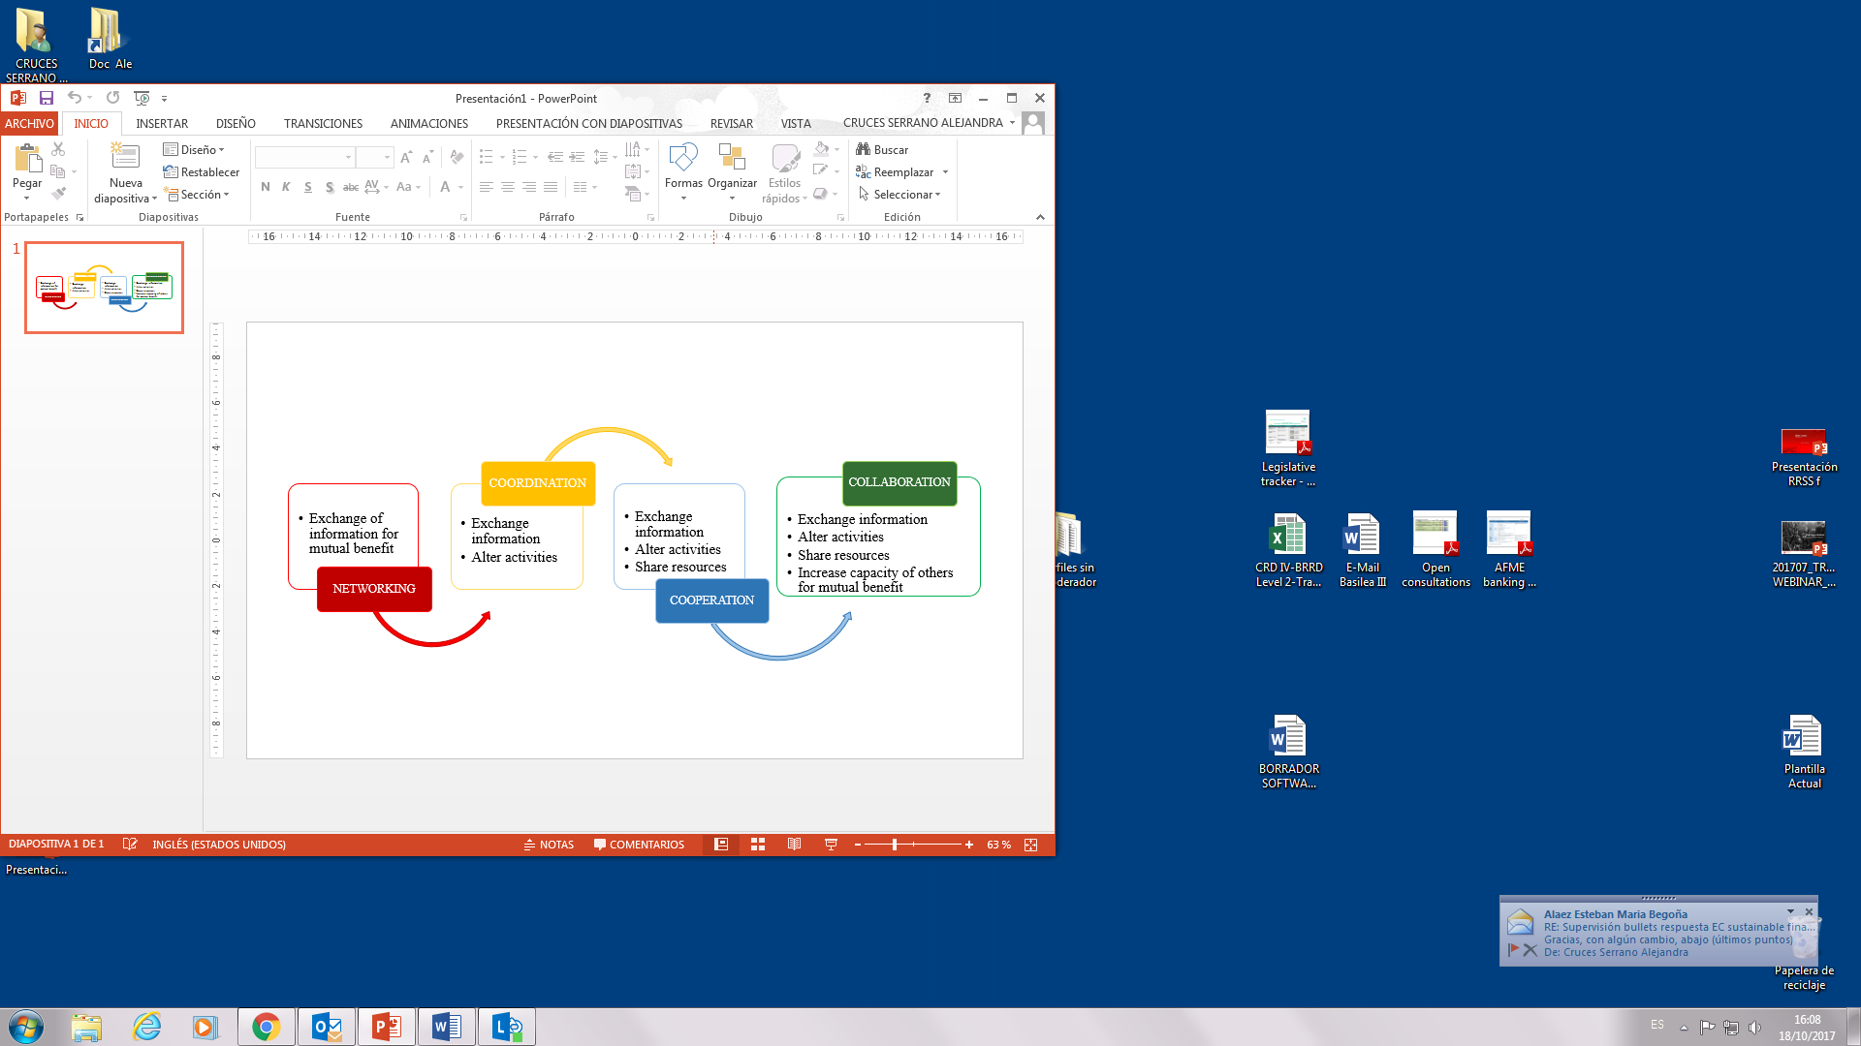
5.2 State of the art – Law enforcement agencies and NGOs dynamics
5.2.2 Looking for collaboration
According to Janine O´Flynn and John Wanna in “Collaborative Governance: A New Era of Public Policy in Australia” (2008):
THE OBJECTIVE: Achieve a way of working together where “the parties share risks, responsibilities and rewards, they invest substantial time, have high levels of trust and share common turf”.
It is necessary to effectively combat a crime that is progressively increasing by enhacing a good collaboration between all relevant actors
Demonstrate the relevance of linking this crime with intelligence analysis
Demonstrate the role NGOs play within wildlife trafficking and intelligence analysis
www.2createffects.co.uk

Slide 13
5.3 Achieving a collaboration between law enforcement and NGOs
5.3.1 The relevance of intelligence
According to INTERPOL and UNEP in their Strategic report of the INTERPOL and UNEP on Environment, Peace and Security (2016) near 90% of surveyed countries considered information and intelligence sharing as one of their most urgent national needs to reduce environmental crime.
PENDING TASKS:
Lack of sharing information and intelligence between units and specialized areas
Improve proactive investigations by increasing number of intelligence analysts
Training programmes both in intelligence analysis and wildlife trafficking
www.2createffects.co.uk

Slide 14
5.3 Achieving a collaboration between law enforcement and NGOs
5.3.2 Criminal Intelligence models: the Intelligence-Led Policing (ILP) approach
What is the ILP approach?
“A management framework for criminal intelligence and planned operational police work, in which intelligence is the foundation for defining priorities, strategic and operational objectives in the prevention and suppression of crime and other security threats” (OSCE 2017).
Decision Making
Communication
The 4-i model
COVERT INFORMATION = RESOURCE FOR STRATEGIC MEANS
www.2createffects.co.uk

Slide 15
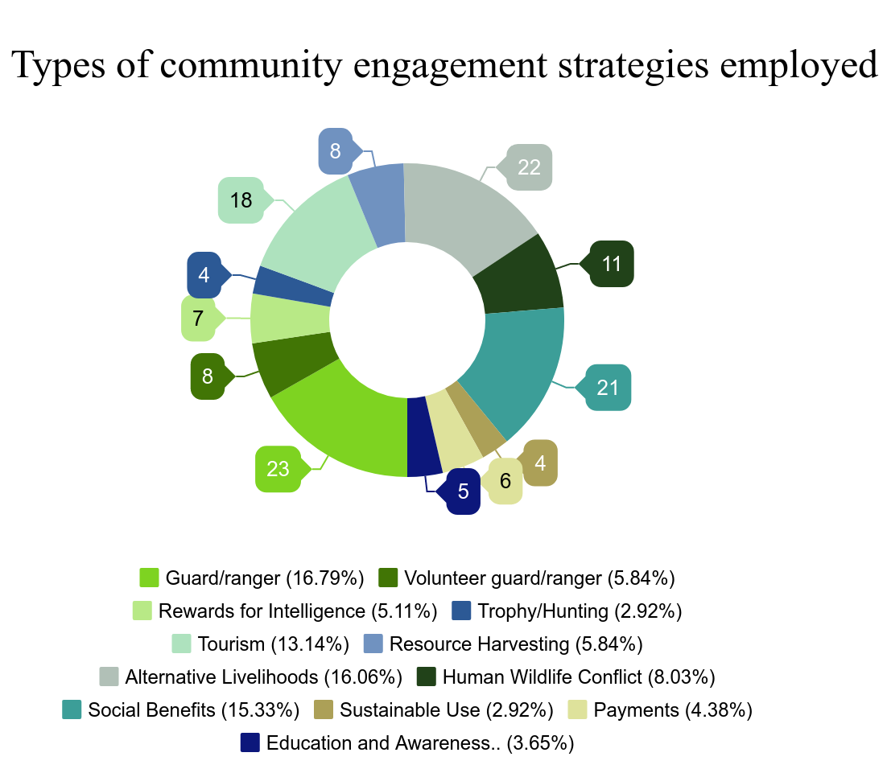
5.3 Achieving a collaboration between law enforcement and NGOs
5.3.2 Criminal Intelligence models: the community-based approach
(2017)
The international community needs a more holistic approach so that:
intelligence-led conservation initiatives can be implemented more effectively.
organized criminal syndicates can be weakened.
Initiatives need to be locally driven, i.e. local communities must participate in defining the solutions according to their local context.
Rewards for intelligence should be increased.
NGO´s play a great role in this intelligence approach.
RESULT: Intelligence reserves are widened.
Booker, F. and Roe, D. (2017) First line of defence? A review of evidence on the effectiveness of engaging communities to tackle illegal wildlife trade.
www.2createffects.co.uk

Slide 16
5.4. What could be done in the short-middle term?
REDUCTION OF NGOs´ PROBABILITY TO COMMIT ILLEGAL ACTIONS BY INCREASING, BOTH LAW ENFORCEMENT AND IGOs, THEIR COMMITMENT IN WILDLIFE TRAFFICKING
ACHIEVE A COLLABORATIVE CULTURE OF INTELLIGENCE SHARING
KEEP THE PACE WITH THE DEVELOPMENT OF NEW TECHNOLOGY BUT KEEPING CONFIDENTIALITY SAFE
TRAINING FOR LAW ENFORCEMENT AND NGOs
Global Partnership Strategy
National Standard Intelligence Collection Plan
5x5x5
Intelligence Requirements Management Syst.
www.2createffects.co.uk

Slide 17

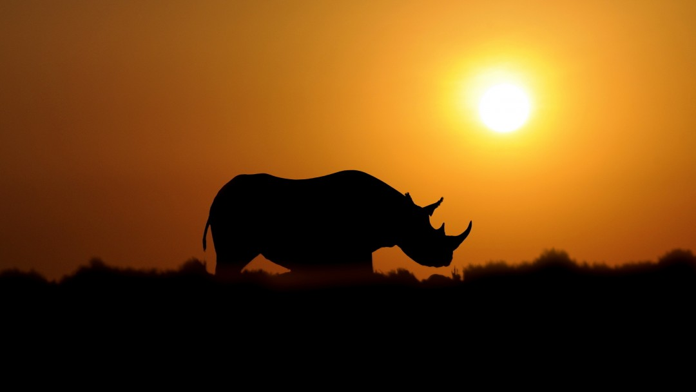
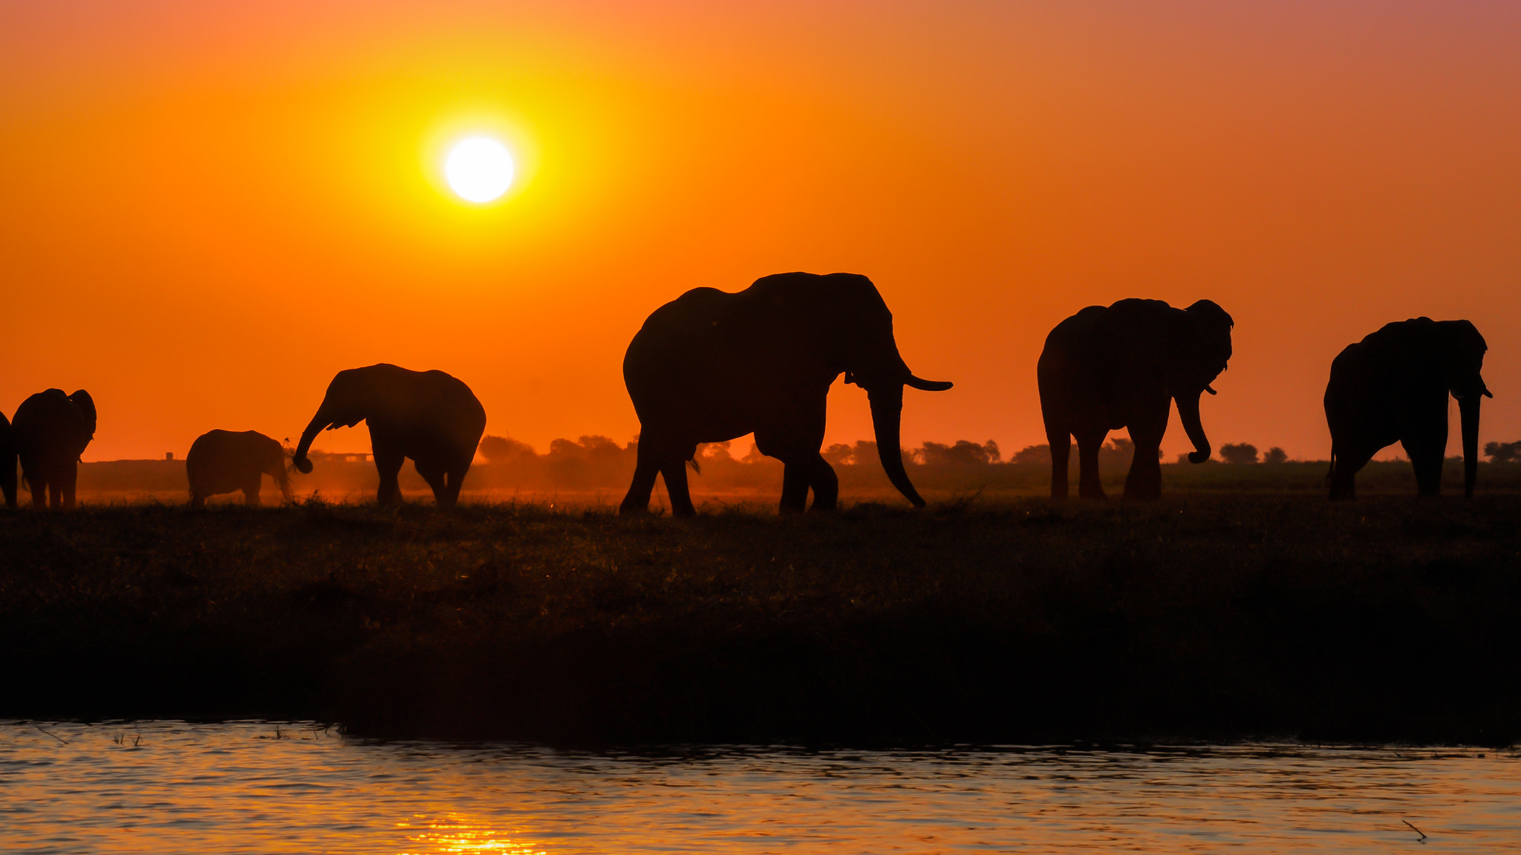
Cambridge Wildlife
Crime Forum
“The most dangerous worldview is the worldview of those who have not viewed the world.”
(Alexander von Humboldt)
THANK YOU FOR YOUR ATTENTION
Alejandra Cruces Serrano
chris@2createffects.co.uk
www.2createffects.co.uk

Slide 18
Cambridge Wildlife Crime Forum
30.04.2018
www.2createffects.co.uk
chris@2createffects.co.uk

